Slide 1
Send to Print!
Lessons from the Writing and Publishing Trenches

Slide 2
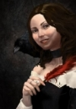
Sidney Reetz
Hellbat Publications
Author of:
Devil’s Codex
Fallen Saint
From the Darkest Corner
Sidneyreetz.com
@sidneyreetz
Megan E. Vaughn
FSF Publications
Author of:
The Emerald Door
Warbirds of Mars
From the Darkest Corner
Fivesmilingfish.com
@fivesmilingfish
Kira Shay
FSF Publications
Author of:
Angel’s Prophecy
Legend of the Strega
From the Darkest Corner
Fivesmilingfish.com
@kirashay11

Slide 3
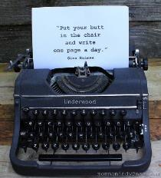
Writing Your Novel- Marching Orders
Write every day.
Only 3% of writers finish their novel
Butt in Chair Time is critical. Sit down and write.
Edit only when the first draft is done.
Read everything you can get your hands on - all different styles and all different mediums.

Slide 4
Writing Groups-
Fellow Soldiers in the Trenches
Pros | Cons
Support Group | Drama
Writing Challenges | Cliquishness
Bouncing Ideas | Time Commitment
Potential Beta Readers | Different levels of commitment
Where to Find Them
Social Media
Nanowrimo Meet Ups
Local Libraries
Start Your Own
Find Beta Readers in Reading Groups

Slide 5
Editing Your Novel-
When the Bombs Have Dropped
Editing is how the first draft becomes a novel
Don’t get discouraged by feedback
Discern between critique and opinion
Remember critiques will only improve your writing.
Stay true to your vision/story/characters
Have someone you trust read your story before publishing
Get a professional copy editor
Take a break from the story between edits

Slide 6
Publishing Paths
Self-Publishing
Traditional
Agents
Book Deals
Book Stores
DIY Marketing
Contracted Amount of Books
No control over covers or pricing
Resources for editing
It’s your Business
You have control
Harder to break into the market
Create your own contacts/ resources for editing, sales, etc.
RESEARCH EVERYTHING

Slide 7
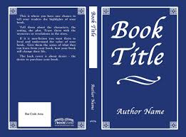
Books Are Judged by Their Covers!
Cover Basics
Back Cover Blurb
Title
ISBN
Image
Author Name
Publisher Info
Spine- Title and Author

Slide 8
Books Are Judged by Their Covers!
Choosing the right Cover Art
DIY Covers
Pre-Made Covers
Artist Commissioned
Pros | Cons | Pros | Cons | Pros | Cons
Creative Control | Lots of work | Easy to pick | Looks Like everything else | Creative Collaboration | Costs $$$
Save $ | Hard to perfect |  | Not personal | Can also create logos/ | Schedules/ Timeframes
 |  |  | Could Cost $ | Unique
Look at other books in your genre - what will make yours stand out?
Does your cover idea show the genre, theme, and feel of your book?

Slide 9
Books Are Judged by Their Covers!
Working with Artists
Do’s:
Don’ts:
* Ask about their commission process
* Expect to jump the line in their commission process
* See if they are interested in Cover Art opportunities
* Be inflexible with the design
* Choose an artist you like
* Disrespect their work or their time
* Create a mutually agreeable contract
* Assume anything - be sure to ask questions
* Always give them credit for their work. Always.
* Ask about formatting the art to a cover template
Where to Find Artists
* Ask if they can do logo’s
Deviant Art, Conventions, Instagram
* Be clear in the contract in regards to payment- royalties vs flat fee
* Ask for their input into the piece- make it a collaboration

Slide 10
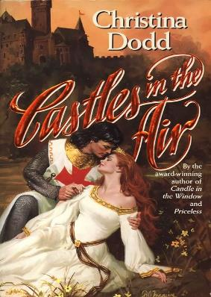
Books Are Judged by Their Covers!
Cover Examples

Slide 11
Books Are Judged by Their Covers!
Cover Examples

Slide 12
Formatting Your Novel
It’s a Pain!
Check distributors’ formatting requirements
Page Numbers
Page Sizing
Embedding Fonts
Pictures in Text
Widows and Orphans
Gutters
Tips on Formatting:
www.fivesmilingfish.com
www.sidneyreetz.com
Distributors & Print Runs
Ingram Spark/ Lightning Source
Smashwords
Print Proofs
E-Books

Slide 13
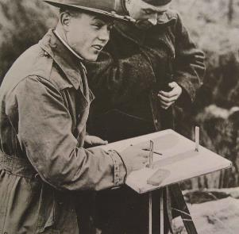
Boring Legal Stuff
(that will give you a headache)
Registering your Business (Sole Prop, LLC, Inc., etc)
Business Licenses for City, State, and sometimes county
Monthly Transaction Privilege Taxes per city and county
Hire someone to help - it’s worth the money
Copyrighting and Trademarking business name

Slide 14
Where and how to sell your books
Author Website
Conventions
Etsy, Store Envy, etc
Book Festivals
Book Signings
Consignment Programs at Indie Book Stores
Books don’t go bad!

Slide 15
Marketing and Promotion- How to Get the Word Out
Word of Mouth
Promotions, Freebies, and Contests-getting people to interact
Have an active author website
Social Media Presence
Book Reviews
Get Creative and Get Noticed
Blogs, Vlogs, and Tutorials- Make a name for yourself as an expert

Slide 16
Writing and Publishing Resources
Take all advice with a grain of salt
Tucson Festival of Books
Nanowrimo
Stephen King’s On Writing
Writer’s Digest
Full list of resources available at
fivesmilingfish.com or sidneyreetz.com

Slide 17
Lessons from the Battle
Realistic Expectations
Never give up
Patience
Research Everything
Talk to people in the industry
Define your own success
Take all advice (even this) with a grain of salt

Slide 18
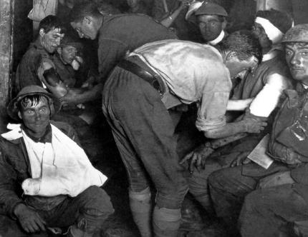
Shell-shocked
Is It All Worth it?

Slide 19
Questions?

